Slide 1
Applications of Sequences and Series

Slide 2
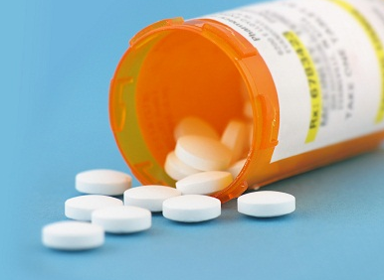
Time to take your medicine!
A patient is prescribed a 250 mg dose of an antibiotic to be taken every 8 hours for 3 days. The drug is both excreted and metabolised so that only 5% of a single dose remains in the body at the end of 8 hours. How much of the drug is in the patient at the end of the 3-day treatment?

Slide 3
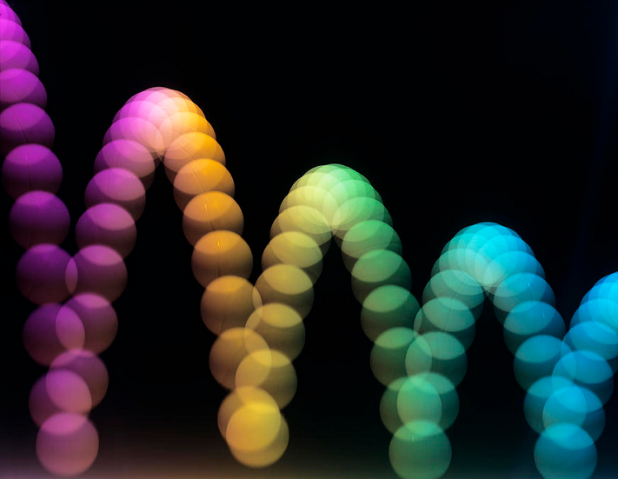
That’s how the ball bounces
A ball is dropped from a height of 4 m and bounces ¾ of the previous height on each bounce.
Express the heights as a sequence – what kind is it?
What is the height of the 12th bounce?
For how long will the ball bounce?

Slide 4
Do you really have time for this?
The time taken to fall distance “h” is , show that the ball in the previous example stops bouncing after a finite amount of time!
Calculate this time.

